Slide 1



Human vision and visual display
Anique Khadim
Saad Rehman Raja
Ahad Ali Zafar
Jibran Naeem
Hamza Mehmood

Slide 2



AGENDA
1 | Introduction
2 | Overview of Human Vision
3 | Visual Perception and Cognition
4 | Color Perception
5 | Visual Hierarchy and Layout
6 | Typography and Readability
7 | Display Resolution and Pixel Density
8 | Motion and Animation
9 | Accessibility and Universal Design
10 | Usability Testing and User Feedback

Slide 3


INTRODUCTION
This presentation aims to explore the intricacies of human vision and how it influences the design of visual displays in HCI..
Understanding human vision is essential for creating interfaces that are intuitive, engaging, and accessible

Slide 4


INTRODUCTION
Understanding human vision is crucial for creating intuitive, engaging, and accessible interfaces.
Human vision is a complex process involving the eyes, optic nerves, and the brain.

Slide 5
INTRODUCTION
Visual perception and cognition play a significant role in how we interpret and organize visual information.
Color perception and its impact on interface design is an important consideration.
Visual hierarchy and layout design guide users' attention and improve usability.
Typography and readability choices greatly affect how users interact with textual elements in interfaces.
Display resolution and pixel density influence the clarity and quality of visual displays

Slide 6




OVERVIEW OF HUMAN VISION
Human vision is a complex process that involves the eyes, optic nerves, and the brain
The eye captures light and converts it into electrical signals that are sent to the brain for processing.
The understanding of human visual perception is crucial in designing effective visual displays in HCI.

Slide 7

OVERVIEW OF HUMAN EYE VISION
Visual perception and cognition in HCI involve the interpretation and understanding of visual information by the brain.
Human eye vision has certain limitations, including variations in color sensitivity, acuity, and susceptibility to visual fatigue.

Slide 8
OVERVIEW OF HUMAN VISION
UNDERSTANDING THE VIEWING DISTANCE AT WHICH USERS INTERACT WITH INTERFACES IS CRUCIAL FOR OPTIMIZING LEGIBILITY AND VISIBILITY OF CONTENT.
ACCESSIBILITY CONSIDERATIONS, SUCH AS ENSURING SUFFICIENT COLOR CONTRAST AND PROVIDING ALTERNATIVE TEXT FOR IMAGES, ARE ESSENTIAL FOR INCLUSIVE HCI DESIGN.

Slide 9

VISUAL PERCEPTION AND COGNITION
Visual perception refers to the interpretation of visual information by the brain.
Cognitive factors like attention, memory, and decision-making shape users' interactions with visual displays.
Gestalt principles, such as proximity, similarity, and closure, influence how we perceive and organize visual information

Slide 10
VISUAL PERCEPTION AND COGNITION
Users' cognitive abilities, such as attention, memory, and decision-making, shape their interactions with visual displays in HCI.
Understanding users' cognitive processes allows HCI designers to create interfaces that align with users' mental models and information processing capabilities.
Visual search patterns, such as eye movement and fixation, can provide valuable information about how users explore and navigate interfaces.

Slide 11


COLOR PERCEPTION
COLOR PLAYS A VITAL ROLE IN VISUAL DISPLAYS AND HCI DESIGN.
THE HUMAN EYE HAS THREE TYPES OF COLOR RECEPTORS: RED, GREEN, AND BLUE CONES.
UNDERSTANDING COLOR PSYCHOLOGY, COLOR HARMONY, AND ACCESSIBILITY CONSIDERATIONS ENSURES INCLUSIVE AND ENGAGING INTERFACES.

Slide 12
COLOR PERCEPTION
COLOR HARMONY AND CONTRAST ARE IMPORTANT CONSIDERATIONS TO ENSURE VISUAL CLARITY AND LEGIBILITY IN INTERFACE DESIGN.
COLOR BLINDNESS AND OTHER VISUAL IMPAIRMENTS NEED TO BE TAKEN INTO ACCOUNT TO ENSURE INCLUSIVITY AND ACCESSIBILITY IN HCI INTERFACES.
AESTHETIC CONSIDERATIONS, SUCH AS COLOR PALETTES AND VISUAL THEMES, CAN ENHANCE THE OVERALL VISUAL APPEAL AND USER ENGAGEMENT WITHIN AN INTERFACE.

Slide 13
COLOR PERCEPTION
Color consistency across different screens and devices improves user familiarity and reduces cognitive load in interface navigation.
Color prototypes and user testing can provide valuable feedback on users' preferences, legibility, and comprehension of color-coded interfaces.
The appropriate use of color in data visualization enhances users' understanding and interpretation of complex information.

Slide 14
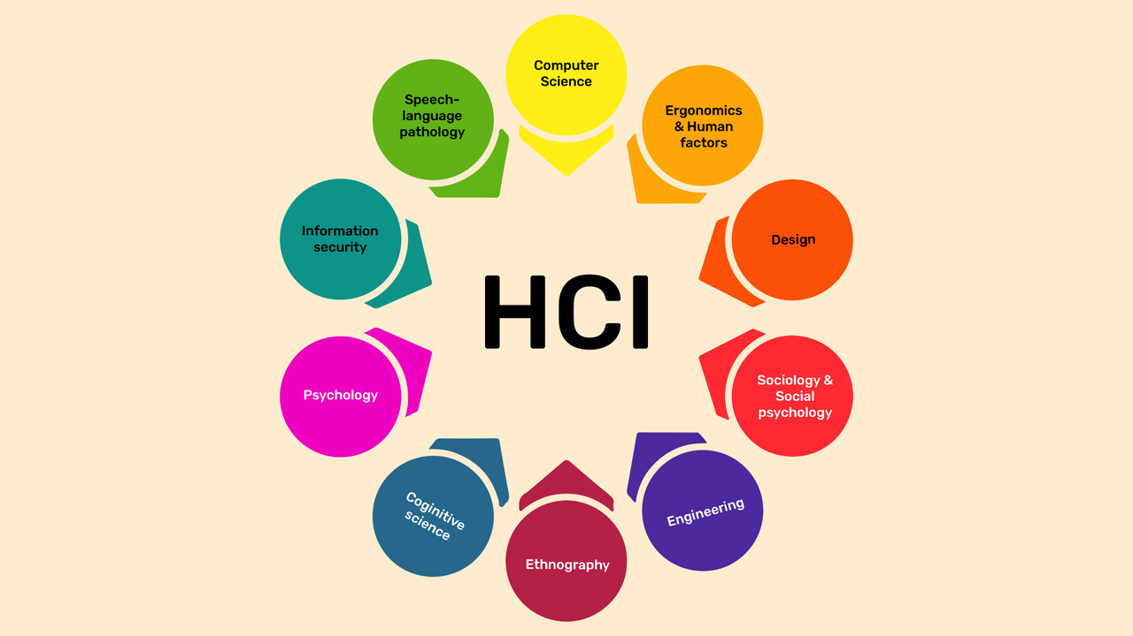
VISUAL HIERARCHY AND LAYOUT
VISUAL HIERARCHY REFERS TO THE ARRANGEMENT OF VISUAL ELEMENTS TO GUIDE USERS' ATTENTION.
VISUAL HIERARCHY INVOLVES ORGANIZING VISUAL ELEMENTS IN A WAY THAT DIRECTS USERS' ATTENTION AND GUIDES THEM THROUGH THE INTERFACE.
PRINCIPLES SUCH AS GROUPING, ALIGNMENT, AND VISUAL BALANCE CONTRIBUTE TO OPTIMAL VISUAL HIERARCHY AND LAYOUT IN HCI.
EFFECTIVE LAYOUT DESIGN ENHANCES USABILITY AND USER EXPERIENCE BY MAKING THE INTERFACE INTUITIVE AND EASY TO NAVIGATE.

Slide 15
VISUAL HIERARCHY AND LAYOUT
RESPONSIVE DESIGN TECHNIQUES ENSURE THAT THE VISUAL HIERARCHY AND LAYOUT ADAPT TO DIFFERENT SCREEN SIZES AND DEVICE ORIENTATIONS.
THE USE OF VISUAL BALANCE, ACHIEVED THROUGH SYMMETRICAL OR ASYMMETRICAL DISTRIBUTION OF ELEMENTS, CONTRIBUTES TO THE OVERALL AESTHETIC APPEAL OF THE INTERFACE.
VISUAL FLOW, CREATED THROUGH DIRECTIONAL CUES AND LOGICAL ARRANGEMENT, GUIDES USERS' ATTENTION AND LEADS THEM THROUGH THE INTERFACE.

Slide 16
VISUAL HIERARCHY AND LAYOUT
Hierarchical navigation structures, such as menus and breadcrumbs, facilitate user exploration and provide a clear path to desired content.
Iterative design and refinements based on user research help create interfaces with optimal visual hierarchy and layout, enhancing usability and user experience.

Slide 17

TYPOGRAPHY AND READABILITY
Factors to consider include font type, size, spacing, and contrast.
Thoughtful typography enhances comprehension and reduces eye strain for users.
Typography choices significantly impact the legibility and readability of text in HCI interfaces.
HCI designers need to carefully consider typography choices to ensure that text is clear, readable, and accessible to a wide range of users.
Contrast between the text and background is crucial for users with visual impairments or in situations with varying lighting conditions.

Slide 18

TYPOGRAPHY AND READABILITY
Typeface weight and style variations, such as bold or italic, can be used to emphasize important information and hierarchy within the text.
Text chunking, using headings, subheadings, and bullet points, helps break content into manageable sections, enhancing readability and information organization.
Hierarchical typography, using different font sizes and styles, helps users understand the importance and relationships between different elements

Slide 19
CAREFUL CONSIDERATION OF THE OPTIMAL LINE LENGTH PREVENTS USERS FROM LOSING THEIR PLACE WHILE READING AND IMPROVES COMPREHENSION.
AVOIDING EXCESSIVE USE OF ALL CAPITAL LETTERS ENHANCES READABILITY, AS IT SLOWS DOWN READING SPEED AND CAN GIVE THE IMPRESSION OF SHOUTING.

Slide 20

Display resolution and pixel density affect the clarity and quality of visual displays.
Higher resolutions and pixel densities enable sharper images and text.
Designing for different device types and viewing distances requires considering various display capabilities.
Viewing distance is also a crucial factor to consider when designing for different displays, as the distance at which users interact with the interface can impact readability and visibility.
Designers need to be aware of the display resolution and pixel density constraints of the target devices and adapt their designs accordingly.
DISPLAY RESOLUTION AND PIXEL DENSITY

Slide 21
DISPLAY RESOLUTION AND PIXEL DENSITY
THE BALANCE BETWEEN DISPLAY RESOLUTION AND DEVICE PERFORMANCE SHOULD BE CONSIDERED TO ENSURE SMOOTH AND RESPONSIVE USER INTERACTIONS.
BALANCING THE USE OF HIGH-RESOLUTION IMAGERY AND THE FILE SIZE TO OPTIMIZE LOADING TIMES AND BANDWIDTH USAGE IS IMPORTANT FOR USER EXPERIENCE.
CONTENT SCALING TECHNIQUES, SUCH AS DYNAMIC SCALING OR RESOLUTION-INDEPENDENT DESIGN, HELP MAINTAIN VISUAL CONSISTENCY ACROSS DIFFERENT RESOLUTIONS AND PIXEL DENSITIES.

Slide 22
DISPLAY RESOLUTION AND PIXEL DENSITY
HIGHR RESOLUTION DISPLAYS CAN ENHANCE THE VISUAL APPEAL OF MULTIMEDIA CONTENT, SUCH AS IMAGES, VIDEOS, AND ANIMATIONS, WITHIN INTERFACES.
OPTIMIZATION OF USER INTERFACE ELEMENTS, SUCH AS BUTTONS AND TOUCH TARGETS, SHOULD ACCOUNT FOR DIFFERENT PIXEL DENSITIES TO MAINTAIN USABILITY AND ACCURACY OF INTERACTION.
CONTINUAL ADVANCEMENTS IN DISPLAY TECHNOLOGY AND INCREASED PIXEL DENSITY OFFER NEW OPPORTUNITIES FOR CREATING VISUALLY STUNNING AND IMMERSIVE HCI INTERFACES.

Slide 23

MOTION AND ANIMATION
Motion and animation can provide visual cues and enhance user engagement in HCI
.
Consideration of motion sensitivity and smoothness is crucial to prevent discomfort or distraction.
Purposeful animation should improve usability and not overshadow the primary content.

Slide 24
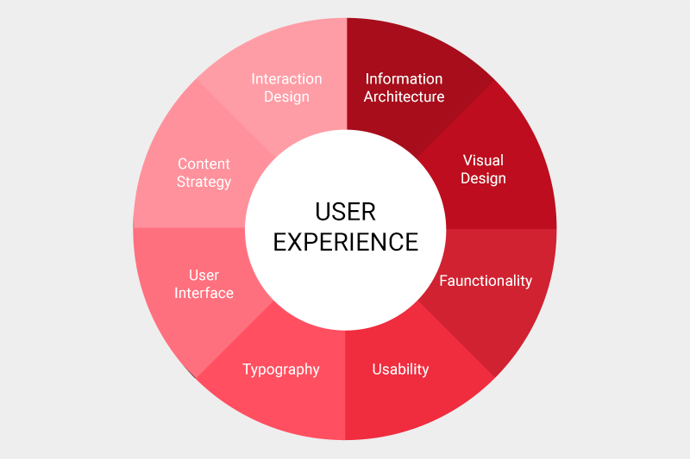
ACCESSIBILITY AND UNIVERSAL DESIGN
ACCESSIBILITY IS A FUNDAMENTAL ASPECT OF HCI DESIGN, ENSURING EQUAL ACCESS FOR ALL USERS.
CONSIDERATIONS SUCH AS COLOR CONTRAST, FONT SIZE, ALTERNATIVE TEXT, AND KEYBOARD NAVIGATION IMPROVE ACCESSIBILITY.
UNIVERSAL DESIGN PRINCIPLES CREATE INCLUSIVE EXPERIENCES THAT BENEFIT EVERYONE, REGARDLESS OF ABILITIES.

Slide 25
Usability testing plays a critical role in evaluating the effectiveness of visual displays in HCI.
USABILITY TESTING AND USER FEEDBACK
Gathering feedback from users helps identify potential issues and areas for improvement.
Iterative design based on user feedback enhances the overall user experience.

Slide 26
CONCLUSION
HUMAN VISION AND VISUAL DISPLAY ARE PIVOTAL IN HCI DESIGN
BY CONSIDERING FACTORS SUCH AS COLOR PERCEPTION, VISUAL HIERARCHY, TYPOGRAPHY, AND ACCESSIBILITY, HCI DESIGNERS CAN OPTIMIZE THE USER EXPERIENCE AND CREATE INCLUSIVE INTERFACES.
UNDERSTANDING THE PRINCIPLES OF HUMAN VISION ALLOWS FOR THE CREATION OF VISUALLY EFFECTIVE AND USER-FRIENDLY INTERFACES.

